Slide 1
STADIOALOT
E-commerce & Logistics Project
Predicting product returns using a Random Forest model
Presenter: Suoma Nuunyango
Date: 26 October 2026

Slide 2
Stakeholders and audience relevance
Who is affected by product returns, and what should each group gain from the analysis?
1. Stadioalot management
Returns reduce profit margins and increase warehouse costs.
Useful next step: Use return-risk insights to prioritise prevention and improve inventory planning.
2. Customers
They may experience inconsistent product satisfaction and delivery outcomes.
Useful next step: Use findings to improve the customer experience without unfairly targeting customers.
3. Warehouse and logistics teams
They face increasing strain from processing product returns.
Useful next step: Use better forecasts to plan capacity, staffing and return handling.
4. Sales and marketing teams
They need insights into high-return products to inform reorder and marketing decisions.
Useful next step: Review product-level patterns before changing pricing, promotion or reorder plans.
Data science experts
The June ROC-AUC of 0.533 and return precision of 18.6% show that the model needs improvement. Further work: verify return labels, test additional features and alternative models, assess threshold trade-offs, and evaluate on later unseen data before operational use.
STADIOALOT • CAP182 | 02

Slide 3
01 • WHY THIS MATTERS
Business context & core problem
R38M annual revenue
54% from retail sales; 27% from the marketing platform.
Returns are rising
Reported return rate increased from 22% (2025) to 29% (2026).
Business impact
Lower retail margins and higher warehouse costs.
Current gap: the business cannot reliably identify which products/orders will be returned.
Flag high-risk products before shipping.
Alert Sales to products with high return risk and support reorder decisions.
Adjust pricing or marketing for high-return products.
Plan warehouse space and inventory around expected returns.
Reduce inventory obsolescence linked to expected returns.
STADIOALOT • CAP182 | 03

Slide 4
02 • PROJECT AIM
Objective & industry context
Project objective
Reduce avoidable returns, improve customer satisfaction, and support inventory and warehouse planning—without harming the customer experience.
Industry context
Online retailers are using historical data and classification models to identify patterns associated with returns.
Retailers face higher-than-expected returns from online purchases.
Data-driven methods can help retailers take a more proactive approach.
Models mentioned in the project context include Logistic Regression, Random Forest and XGBoost.
The intended use is to monitor return risk and support better decisions.
STADIOALOT • CAP182 | 04

Slide 5
03 • SOURCE DATA
Data overview & key limitation
Five synthetic Stadioalot datasets were provided: sales/returns, customer reviews, deliveries, inventory and return policies.
Sales/returns: 2,760 rows × 9 columns; reviews: 3,882 × 6; deliveries: 14,043 × 8.
Inventory: 1,390 × 9; return policies: 8 × 6.
The sales/returns table contains only returned orders, so it cannot alone represent both returned and non-returned outcomes.
The delivery table was used as the broader population and a return flag was derived by matching Order IDs to the returns table.
Important limitation: if the delivery table does not fully specify return outcomes, some orders may be labelled as non-returned incorrectly.
STADIOALOT • CAP182 | 05

Slide 6
04 • CLEANING & QUALITY
Data preparation
Loaded and inspected all five datasets; checked dimensions and missing values.
Standardised column names: lowercase, trimmed whitespace, and replaced spaces/special characters with underscores.
Cleaned text and categorical values to reduce inconsistent labels.
Filled missing refund methods with “Other”.
Filled missing review text using the most common review for the corresponding star rating.
Imputed missing actual delivery dates using each courier’s average delay.
Removed inventory records missing expiration dates.
STADIOALOT • CAP182 | 06

Slide 7
04 • CONTINUED
Data preparation & modelling setup
Standardised data types; kept IDs as strings and converted dates, numeric fields and Boolean values.
Checked date quality, removed records with invalid review dates, and filled missing dispatch dates with expected delivery date minus three days where possible.
Removed duplicate delivery records and created `return_flag` by matching normalised Order IDs.
Saved prepared datasets as CSV files with `preprocessed_` or `imputed_` prefixes.
Filtered delivered orders from January–June 2026 and engineered transit, delay, calendar and region features.
Split chronologically: January–April training, May validation, June unseen test.
Pipeline: median imputation for numerical fields, mode imputation and one-hot encoding for categorical fields, followed by Random Forest classification.
STADIOALOT • CAP182 | 07

Slide 8
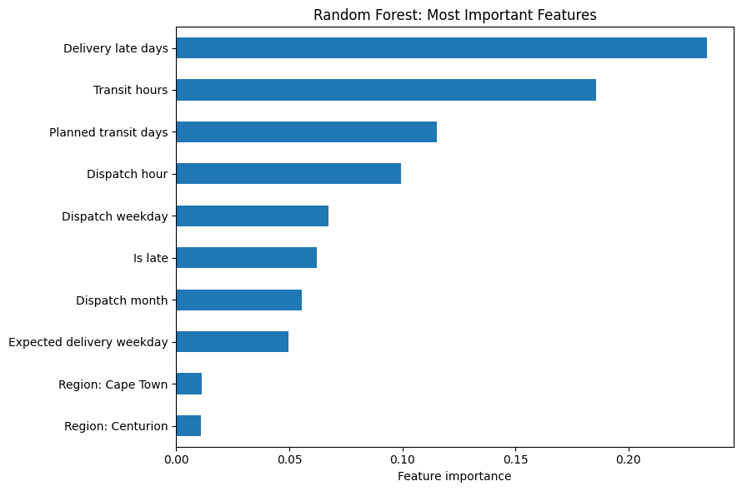
05 • KEY PATTERNS
What signals mattered most?
Delivery lateness: 23.5% of feature importance.
Transit hours: 18.6%; planned transit days: 11.5%.
Dispatch hour (9.9%), weekday (6.7%) and late flag (6.2%) also contributed.
Region and courier categories had much smaller importance scores.
Important: importance shows predictive contribution, not whether lateness increases or decreases return risk.
STADIOALOT • CAP182 | 08

Slide 9
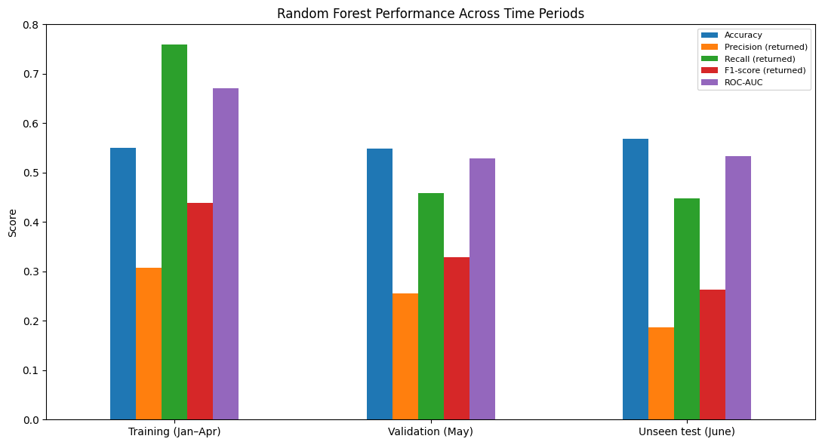
06 • MODEL EVALUATION
How did the model perform over time?
Accuracy: 55.0% training, 54.9% validation, 56.9% June test.
Return recall fell from 76.0% in training to 44.8% in June.
June ROC-AUC was 0.533, indicating weak separation between returned and non-returned orders.
Similar accuracy scores do not, by themselves, prove the model is reliable.
STADIOALOT • CAP182 | 09

Slide 10
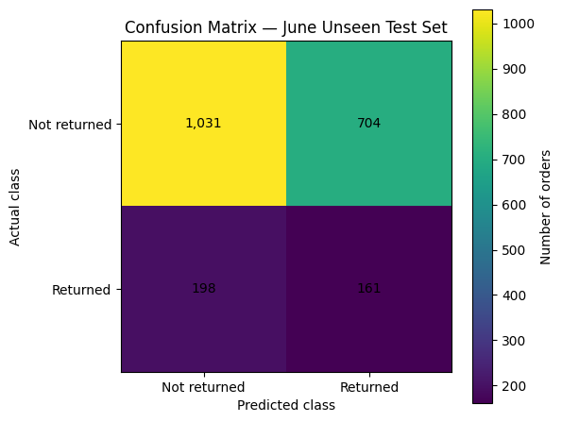
07 • READING THE CONFUSION MATRIX
What happened on the June test set?
1,031 non-returned orders correctly identified.
161 returned orders correctly identified.
704 non-returned orders incorrectly flagged as returns.
198 returned orders were missed.
The model caught 44.8% of actual returns; only 161 of 865 predicted returns were actual returns.
STADIOALOT • CAP182 | 10

Slide 11
08 • MODEL SELECTION
Why Random Forest?
Comparison in SS1
Random Forest was reported as outperforming Logistic Regression on the earlier test metrics.
Earlier reported results
Accuracy 62.90% • Precision 59.73% • Recall 58.38% • F1 59.05% • ROC-AUC 0.6844
Random Forest combines many decision trees rather than relying on one tree.
Each tree considers a random subset of features, allowing different patterns to be learned.
The trees’ votes are aggregated to produce a classification.
The model was selected for its better performance than Logistic Regression in the earlier comparison.
Note: the earlier SS1 results are separate from the later January–June model evaluation shown in this presentation.
STADIOALOT • CAP182 | 11

Slide 12
09 • WHAT THE RESULTS MEAN
Results: strengths & limitations
Overall accuracy
55%–57% across the evaluated periods.
June return recall
44.8% of actual returns detected.
June precision
18.6% of predicted returns were actual returns.
The model’s accuracy is relatively consistent across training, validation and June test data.
On unseen June data, it missed 198 of 359 actual returns—more than half.
It generated 704 false positives, so many flagged orders were not recorded as returns.
The model is not yet strong enough to be treated as a dependable return-risk decision-maker.
The quality of the return labels is a key concern because they were derived by matching Order IDs across the supplied datasets.
STADIOALOT • CAP182 | 12

Slide 13
10 • NEXT STEPS
Recommendation & conclusion
Treat the current Random Forest as an exploratory model, not a fully reliable operational decision tool.
Review the return-flag construction and confirm that non-returned orders are correctly labelled.
Test a lower decision threshold than 0.48 to see whether more actual returns can be identified.
Compare the trade-off: higher return recall may also increase false alarms.
Re-evaluate accuracy, precision, recall, F1-score and ROC-AUC on unseen data after each change.
Use the strongest current signal delivery timing/ lateness as a starting point for further analysis, without assuming it causes returns.
STADIOALOT • CAP182 | 13

